Slide 1
EUROSAI WGEA Progress and Plans
Viire Viss National Audit Office of Estonia
15th INTOSAI WGEA Steering Committee Meeting
11-14 September 2017

Slide 2
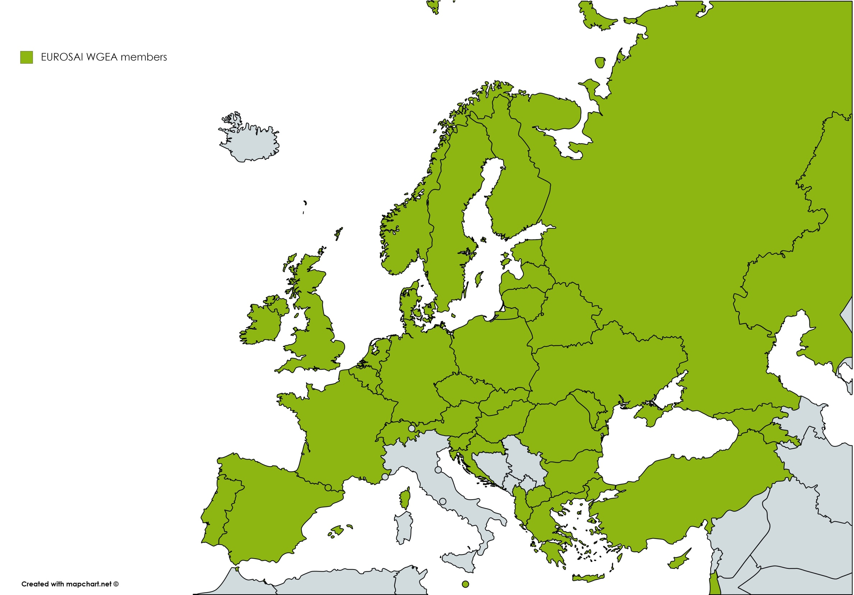
EUROSAI WGEA members
Chair of EUROSAI WGEA:
Estonia
42 member SAIs
Notes:
NAO of Estonia has been the Chair of EWGEA since 2014 and renewed its mandate in 2017 for another 3-year term.
42 members
A new Steering Committee will be introduced at the 15th Annual Meeting in Albania

Slide 3
Strategic Focus for 2017-2020
Professional Cooperation
Experience Sharing
Notes:
Strategic Plan was approved at the EUROSAI Congress in May 2017 and will enter into force at the EWGEA Annual Meeting.
New working period focuses on two strategic goals, which have been set by members of EUROSAI WGEA:
1. Encourage and support professional cooperation
2. Facilitate knowledge and experience sharing
Through its activities, the EUROSAI WGEA aims to promote a spirit of cooperation based on integrity, open communication and professional excellence
EXPERIENCE SHARING
A key focus for the EUROSAI WGEA is to enhance the members’ abilities to conduct environmental audits. Therefore, the EUROSAI WGEA facilitates knowledge and experience sharing on common environmental auditing topics, various auditing tools and methods. EUROSAI WGEA aims to provide updated information and knowledge from relevant experts within and outside the SAI community.
COOPERATION
One of the main goals of EUROSAI WGEA is also to encourage and support cooperation. We promote cooperation within our members, in wider SAI community (e.g. EUROSAI, INTOSAI, regional working groups), as well as with external partners (e.g. European Union institutions). Furthermore, cooperation is supported in different formats, such as cooperative audits, common seminars, etc.
EUROSAI WGEA aims to be a source of inspiration, providing a forum for SAIs with common interests to meet and find topics for cooperative activities. The Secretariat supports the emerging initiatives and offers advice where needed.
A NEW FORM OF COOPERATION within EUROSAI WGEA – Developing a MOOC (on Auditing Water Issues)

Slide 4
Training
Sustainable development
Spring session
Water Quality and Management
Training
14th Annual Meeting
15th Annual Meeting
MBIs for environmental protection ISSAIs of environmental auditing
Data and Analysis in Environmental Audit
Land Use and Development
Greening the SAIs
2016
2017
Notes:
One of our main goals and challenges: Encouraging SAIs to include, besides environmental aspect, also economic and social aspects of sustainable development in audits
The EUROSAI WGEA follows the integral global matters, such as sustainable development and environmental health, while focusing its activities on regionally relevant environmental auditing issues, as identified by our members.
Nendest üritustest juba rääkis eelmine aasta:
Training Seminar on Auditing Sustainable Development – Skopje, Macedonia – October 2016
Included a panel of Head of SAIs. Sustainable development helps to broaden audits’ scope both by sectors and by time scale. Governments are structured into silos of ministries and often the horizontal overview is lacking. Auditing from SD perspective enhances obtaining the birds-eye view as SD is about connecting the economic, social and environmental dimensions.
14th Annual Meeting – Skopje, Macedonia – October 2016
Nendest ei ole veel rääkinud:
Spring Session on Water Quality and Management – Ljubljana, Slovenia – April 2017
The spring session was dedicated on auditing different aspects of water quality and management, covering topics such as availability and sustainable management of water, conservation of fresh water ecosystems, connection with the Sustainable Development Goals and SAIs' role and experience in auditing these issues.​This seminar will also give a great input for an upcoming project of developing a Massive Open Online Course (MOOC) on Auditing Water Issues.
UPCOMING:
Training Seminar on Data and Analysis in Environmental Audit – Tirana, Albania – October 2017
The objective of the training seminar is to:
Introduce the main types and characteristics of environmental data
Provide an overview of the main sources for environmental data in the European region
Discuss the aspects of choosing the right data for environmental audits
Introduce some most common analyses tools and methods
Implement the theory in practical exercises
15th Annual Meeting – Tirana, Albania – October 2017
Land Use and Development: e.g. Urban sprawl in Europe – how to ensure resilient and sustainable living environment; Sustainability of farmed and forest areas
Greening the SAIs: practical experiences and concrete plans related to implementing green office principles

Slide 5
Ongoing Cooperative Audits
Cooperative Audit on Air Quality
Cooperative Audit on Energy Efficiency in Public Buildings
Cooperative Audit on Mediterranean Marine Protected Areas
Notes:
Cooperative Audit on Air Quality – led by SAI Poland and the Netherlands
Cooperative Audit on Energy Efficiency in Public Buildings – led by SAI Estonia, Latvia, Lithuania
Cooperative Audit on Mediterranean Marine Protected Areas – led by SAI Cyprus and Malta
All 3 started in early 2017 and joint reports should be published in 2018.

Slide 6
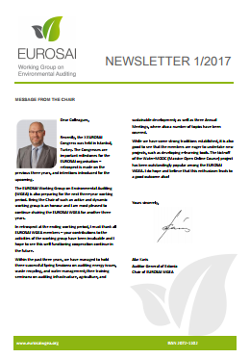
Other activities
EUROSAI WGEA website
Newsletter
Cooperation with:
regional WGEA
EU institutions
other stakeholders
Notes:
EUROSAI WGEA has presented annual Progress Reports to EUROSAI GT3 as well as Governing Board.
Furthermore, the working group has been represented at various events of other regional WGEA and other stakeholders during the previous working periood:
• INTOSAI WGEA Assembly Meetings
• INTOSAI WGEA Steering Committee Meetings
• EUROSAI-OLACEFS Joint Conference
• Second Young EUROSAI Conference
• AFROSAI WGEA Annual Meeting and Training Seminar
• ASOSAI WGEA Annual Meeting
• ARABOSAI WGEA Annual Meeting
• XXII INCOSAI Congress
• IDI Planning Meeting for Auditing SDGs Programme
• Conference on Environmental Compliance Assurance
• ECA Seminar on Auditing Energy and Climate

Slide 7
Thank you!
Find out more about our activities at
www.eurosaiwgea.org

