Slide 1
13 September 2017 Training tool on Greening of Supreme Audit Institutions Project plan overview
Presentation by
Dilyanka Zhelezarova & Viire Viss

Slide 2
Content
What is greening?
Background
Participants / Responsibilities
Project objective and outcome
Project scope
Planned methodology and key milestones
Feedback and suggestions?

Slide 3
What is this „greening“?
Strategic commitment
Structured way to deal with your office’s environmental impacts and to improve working environment
„Auditing“ your own environmental impacts, not others’☺
Involvement and awareness rising
Not reinventing the wheel – using the methodologies and experience of others

Slide 4
Background
INTOSAI Strategic Plan 2017-2022, crosscutting priority 2;
“Green” SAIs represent an example with their public declaration of good practice;
Research paper “Greening SAIs” is a good basis for developing practical training from “words to action” for SAIs;
In its work plan for 2017-19 the INTOSAI WGEA committed to developing a training project on Greening of SAIs.

Slide 5
Participants / Responsibilities
Project leaders:
the European Court of Auditors (ECA) and the National Audit Office (NAO) of Estonia
Subcommittee members:
SAIs of Cameroon and India
WGEA Steering Committee members
RWGEAs, members of INTOSAI WGEA
Notes:
Overall, over 80%

Slide 6
Project objective and outcome
To develop a training Toolkit that provides a conceptual framework for the SAIs based on general greening principles;
Interactive training session with corresponding materials on greening concepts and measures:
greening activities at the office level;
easy and common greening activities to implement;
On-line templates will be provided to support the implementation of greening activities:
mapping office’s environmental aspects and
set of performance indicators on various environmental topics and office activities.

Slide 7
Project scope
Address SAI’s own management and performance related measures to reduce the negative impact of their own activities;
Provide good practices and tips;
Guide for Project Leaders: How to Develop INTOSAI WGEA Training Materials;
Building on the Greening SAIs research paper (2016);
In the future, reporting on greening exercises may be conducted regularly on the basis of SAI’s feedback and self-assessments.

Slide 8
Planned methodology and key milestones
Research on most recent “greening” developments and practices across the world;
Brainstorming session at the EUROSAI WGEA meeting in October 2017;
Explore the potential training topics at a focus group discussion during the WGEA Assembly in spring 2018;
Deliver pilot training on greening to the representatives of the RWGEA at the Steering Committee meeting in November 2018, or at iCED around the end of 2018;
To identify easy-to-implement solutions throughout the various methods, and include them in the training toolkit.
Notes:
Lesotho comment: The Draft Plan is clear except where the project team would want to use RWGEA representatives to pilot the toolkit while they would be attending meetings with other members; like during the 18th Assembly Meeting and 16th Steering Committee Meeting, how are they going to be singled-out from the rest of members?
Suggested answer: The purpose of the focus group discussion during the Assembly in spring 2018 is to identify the SAIs expectations, and the workshops are usually attended on the basis of SAIs interests;
The pilot training is intended to be delivered as a complementary session at the SC meeting in November 2018. However, both events are subject to an agreement with the Secretariat. Alternatively, as suggested in the PP, the pilot training could be conducted during the annual International Training Programme on Introduction to Environment Audit at iCED around November-December 2018.

Slide 9
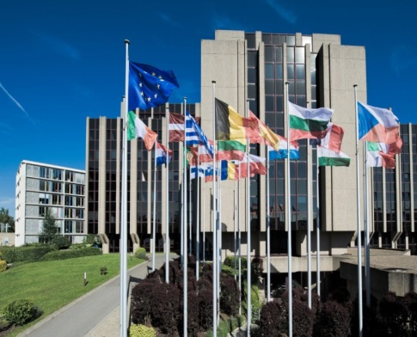
What we have done in ECA
EMAS registration and ISO14001 certification
http://www.eca.europa.eu/en/Pages/Environmental-management.aspx
Plan-do-check-review approach, review of direct and indirect impacts of our own activities (carbon dioxide emissions, energy, water and paper consumption);
Targets and actions to systematically cutting our CO2 emissions;
Measuring the significant aspects of our core activities against environmental performance indicators;

Slide 10
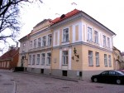
What have we done? NAO of Estonia
Office: one site (2500 m2), new office building (renovated, from 18th century), approx. 100 employees
Green Office principles (www.eugreenoffice.eu)
BEFORE and AFTER evaluation (to come)
NAOs Green Week 2017 (18-22 Sept)
Notes:
Overall, over 80%

Slide 11
Thank you

Slide 12
Feedback and suggestions?

