Slide 1
Audit Guideline on Delivering the 2030 Agenda through Environmental Audit
WGEA’s 2017-2019 Work Plan
Goal 1 - Developing guidance materials available to SAIs
Action 2.1 (h)
Leaders – Canadá, Indonesia and Brazil
Subcommittee – USA, Arabosai, Cameroon, Cambodia, India, Iran Malasya, Pkstan and South Africa

Slide 2
Outline
INTOSAI’s Strategic Plan for 2017-2022
IDI Initiatives
Project Objective and Outcome
Project Scope
Proposed Draft Outline
Methodology
Comments of SC Members
Timeline and Key Milestones

Slide 3
INTOSAI’s Strategic Plan for 2017-2022
Crosscutting Priority 2:
“contributing to the follow-up and review of the SDGs within the context of each nation’s specific sustainable development efforts and SAIs’ individual mandates”
IDI Initiatives

Slide 4
Why Develop Audit Guidance on SDGs Environmental Perspective
SDGs
Common Language
Consolidation
Transparency
Capacity Building
Notes:
SDG brought an important framework government to achieve public policy results. Its about a common language that foster the government to have important components of governance. Like good planning that foresees the strategy to reach the goals. Good coordination, good integration, transparency about the resources, infrastructure, budget, results.

Slide 5
Audit framework
Method for preparedness audit in SDGs
Center of Government
Agency A
Agency B
Whole-of-government approach
Policy A
Policy B
Policy C
cross-cutting
SDG Target
SDG Target
SDG
Target
Notes:
The preparedness audit perspective adopts the "Whole-of-government" approach. This means that the evaluation relies on the whole structure that government can use to achieve goals and targets - which includes the center of government, the various agencies and multiple public policies that can positively or negatively influence the achievement of those goals and targets.
The approach should allow to identify and assess coherence between center of the government agencies and if there are omissions, fragmentation, overlapping and duplications among the policies and the agencies mandate and acting.

Slide 6
Governance mechanisms
Approach for preparedness audit in SDGs
Center of government
Strategy
Coordination
Transparency
Supervision
Institutional
SDG target
Internalization
Cross-cutting coordination
Integrated monitoring
Transparency and participation
Notes:
We should assess governance structure in the level of the Center o Government and in the level of the SDG target. In the center of the government we are expected to assess the components of Intitutionalization, that means legislation, responsible agencies, structure. How the strategy is set in the planning system. How the government coordinate the different bodies that deliver the public policies, programs and activities, related to the SDG, from a systemic perspective, and how they supervise and bring transparency to their goals and its results.

Slide 7
Global Governance Index
Approach for preparedness audit in SDGs
GOVERNANCE COMPONENTS
0
1
2
3
Establishing
Developing
Optimized
No implementation
Absence of structure | Defined structure | Implemented structure | Best practices
Notes:
The Global Governance Index, is supposed to be a common language to communicate the level of compliance with each governance component

Slide 9
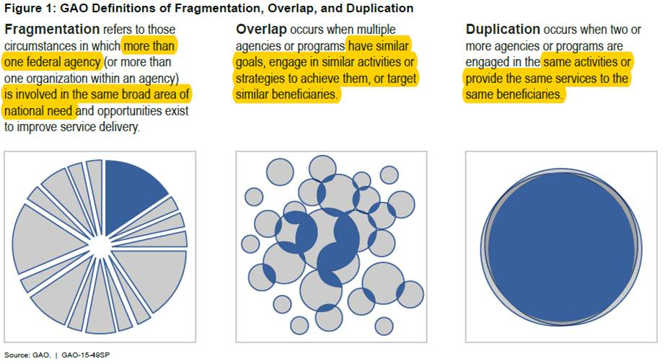
FOD methodology adapted
Approach for Performance audit in SDGs
Fragmentation
Overlap
Duplication
Omission
Notes:
The preparedness and performance audit approach is based on the GAO evaluation model of Fragmentation, Overlap and Duplication. The audit approach developed by TCU also includes the evaluation of omissions.
We adapted the FOD/GAO model to SDGs perspective and inserted the omission aspect.

Slide 10
Sustainable Food Production – Target 2.4
Sustainable alternatives
Low carbon
Organic Production
Agrochemical reduction
Technical Assistance

Slide 11
Sustainable Food Production – Target 2.4
Low carbon
Sustainable alternatives
Low carbon
Sustainable alternatives
Organic Production
Organic Production
Agrochemical reduction
Technical Assistance
Agrochemical reduction
Technical Assistance
Farmers loan and crop insurance
Fiscal policy
Agrochemical
Notes:
Applying the audit model developed to evaluate the preparedness of the Brazilian government to achieve the goal of sustainable food production, we find public policies that contribute positively to the goal, such as the production of organic and low carbon foods.
Technical assistance encourages producers to use pesticides, contributing negatively.
In Brazil, there are no policies that encourage the reduction of pesticides and the adoption of sustainable alternatives, which are considered as omissions.
Finally, credit and insurance policies require the use of pesticides, and the tax policy exempts the importation of pesticides, contributing negatively.

Slide 12
Project Objective and Outcome
provide SAIs with concepts, tools, and examples
Provide a model for environmental auditing on SDG perspective based on assessing horizontal, vertical policy coherence of crosscutting issues and fragmentation, overlapping, duplication and omission.
Notes:
Prioritization and selection matriz
set of criteria that includes relevance, materiality, criticality and value aggregation

Slide 13
Project Scope
Understanding the 2030 Agenda
The main challenges in implementing SDGs;
SAIs role in monitoring targets and indicators, and auditing programs, governmental plans and public policies;
Types of audit
Sources of audit criteria
Audit tools and methods
Environmental crosscutting issues

Slide 14
Proposed Draft Outline
Background
3 Dimension
SAIs Role
Steps
Audit Impact
Government Response
Case Studies
Crosscuting Issues
Audit Scope and Criteria
Tools and Methods

Slide 15
Methodology
Literature review
Survey
Experts
Draft

Slide 16
Comments of SC Members
SAI | COMMENTS
Czech Republic | Consistency and linkage of the final reports from all projects
Lesotho | Repetition of objectives and outcomes under scope
India | 1 - change the name of the project to "Conducting environmental audits through the perspectives of Sustainable Development Goal” 2 – Linkage to others WGEA issued guidelines.
Estonia | adding one topic to the guideline “Planning audits with sustainability lens”.
ECA | some general facts about Agenda 2030 are missing to understand better expected outcomes

Slide 17
Timeline and Key Milestones:
Stage | Action | Date
1 | Project Plan Draft to WGEA Secretariat | May 2017 ✔
 | Receive comments from Steering Committee | May – June 2017 ✔
2 | Review and Approve Project Plan at 15th Steering Committee Meeting in Washington, USA | September 11 – 14 2017
3 | Final Version of the Project Plan | October 2017
 | Final Confirmation of Project Survey Questions to WGEA Secretariat | November 2017
5 | Elaborated Project Table of Contents to the WGEA Secretariat | December 2017
6 | 18th WGEA Assembly (Discuss Projects, Undertake Project Discussion Forums) | March 2018
7 | Project Approval - 16th Steering Committee Meeting (Approval of the Project Output, Dicussion of Next Work Plan) | November 2018
8 | Final Draft of the Project Output to the WGEA Secretariat | February 2019
9 | Final Version of the Project Output | June 2019
10 | 19th WGEA Assembly | September 2019

Slide 18
Thank you!!!

