Slide 2
Project Work Plan 2017-2019 Environmental Health (Focus on Air Pollution) Project Leader: SAI Philippines

Slide 3
Status of Air Pollution Worldwide

Slide 4
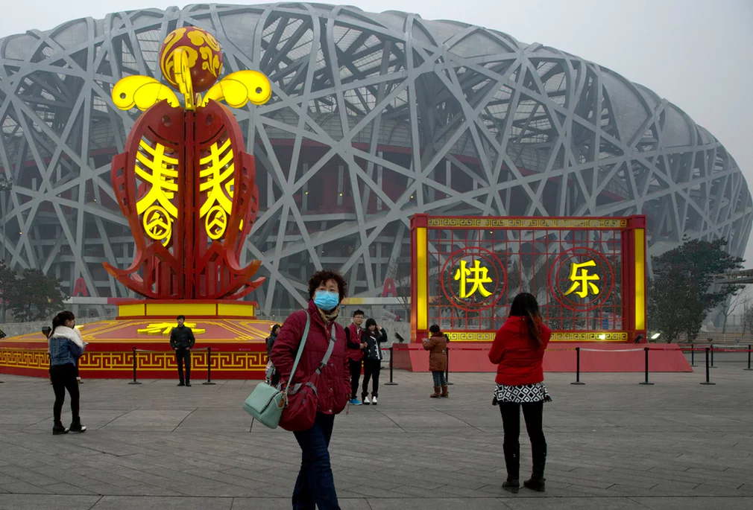
China

Slide 5
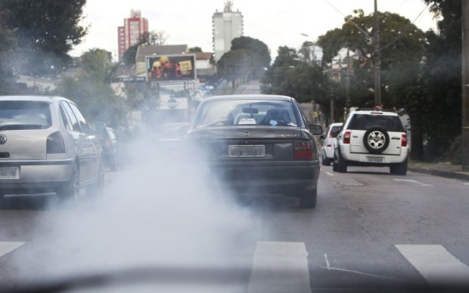
Brazil

Slide 6
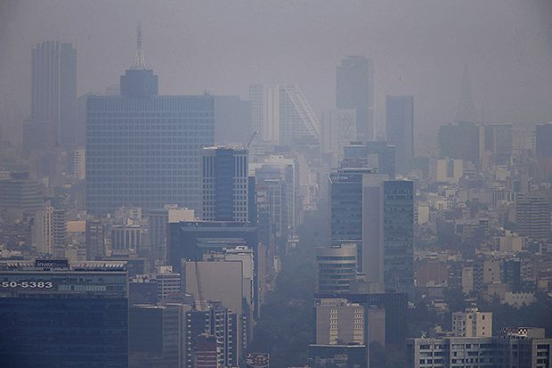
Mexico

Slide 7
Thailand

Slide 8
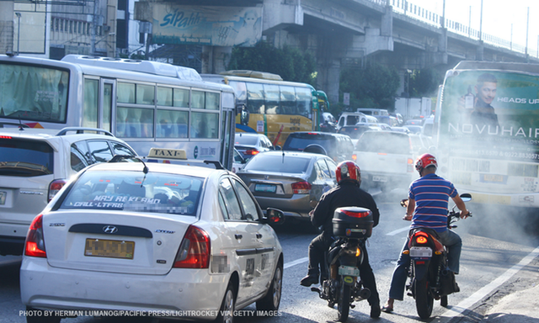
Philippines

Slide 9
Effects of Air Pollution on Health

Slide 10
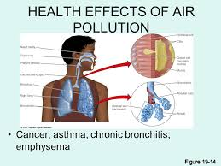

Slide 11
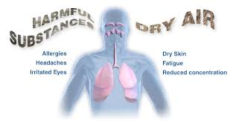

Slide 12
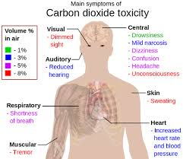

Slide 13
Background
Environmental pollution is one of the serious crisis to which we are facing today.
Agreement in the United Nations Environment Assembly held in Nairobi on June 23-27, 2014
Estimates by World Health Organization (WHO), air pollution responsible for seven million deaths annually
As reported by OECD, cost of the health impact of air pollution in OECD countries (including deaths and illness) was about USD 1.7 trillion in 2010.
In China, cost of health impact of air pollution was about USD 1.4 trillion in 2010 and about USD 0.5 trillion in India.

Slide 14
2030 Sustainable Development Goals (SDGs)
Goals 3 and 11, air quality and its impact on human health was considered as one of the top priorities
Goal 3 - Envisions to Make Cities and Human Settlements Inclusive, Safe, Resilient and Sustainable by reducing the adverse per capita environmental impact of cities, including by paying special attention to air quality and municipal and other waste management
Goal 11 - Ensure Healthy Lives and Promote Well Being for All Ages through substantial reduction of the number of deaths and illnesses from hazardous chemicals and air pollution and contamination, among others.

Slide 15
Project Objectives
The project aims to:
Identify and describe the issues and risks related to environmental health, with focus on Air Pollution, in which the governments worldwide are faced with that needed concrete response measures;
Find out how international organizations can assist/support in surmounting the effects of air pollution on health; and

Slide 16
Project Objectives
c. Describe the challenges of SAIs in auditing these issues and identify the best strategies and practices which will assist SAIs to face and overcome these challenges.

Slide 17
Project Scope
Issue Area #1: Effects/Impact of Air Pollution to Environmental Health
The chapter covers the following:
Definition of air pollution
Categories of air pollution
Types of common pollutants
Sources of air pollution
Who are vulnerable to air pollution
Effects/Impact of air pollution on health
Diseases related to air pollution

Slide 18
Project Scope
Issue Area #2: Risks to governments due to effects of environmental health related to air pollution
This area discusses on:
Risk on access to information on levels of air pollutants and their main sources of pollutants
Risk on lack of awareness about the health burden on air pollution
Risk to environment and human health
Financial risks related to air pollution and human health

Slide 19
Project Scope
Issue Area #3: Role of governments in responding to the effects of environmental health related to air pollution
This area focuses on:
Efforts undertaken by slected governments worldwide to determine the level of air pollution in their own country as well as its impact on public health
Policies and/or programs and strategies taken by these governments reduce and combat air pollution and its health impact
Evaluate the cost-effectiveness of policies and/or programs and strategies of these governments against air pollution and its effects on health

Slide 20
Project Scope
Issue Area #4: Efforts of International Organization on Air Pollution
This chapter will discuss on:
International assembly/congress on air pollution
Responses of international organizations in helping governments reducing and combatting air pollution and its health effects
Assistance and provision of funding sources in support on programs and projects related on impacts of air pollution on health

Slide 21
Project Scope
Issue Area 5: Describe the challenges faced by SAIs in auditing these issues and identify the best approaches and practices which will assist SAIs to overcome these challenges
This issue area covers:
The scope, objectives and types of audits conducted by SAIs represented in the audit analysis and survey
Challenges faced by SAIs in auditing air pollution and its impact on health and their strategies employed in overcoming the barriers
Identifying the SAIs best audit practices
Obstacles/Hindrances faced by other SAIs who have not yet engaged in audit air pollution and its health impact

Slide 22
Planned Methodology
Literature Review
Study of Different SAIs Audit Reports
Reference to recent publications of Organization for Economic and Development (OECD) and European Environmental Agency related to air pollution and its impact on health
Review of the concluded cooperative and parallel audits of WGEA SAI members related to the subject of the Project as references

Slide 23
Planned Methodology
5. Discussion Panels with Experts and Academe
6. Analysis of information and case studies gathered through survey to the WGEA community
7. Information and data exchange, by email, with the members of the subgroup on the project.
8. Workshops and work sessions during the meetings of the WGEA members, specifically with the Steering Committee.

Slide 24
Proposed Timeline and Key Milestones
Stage | Action | Date
1 | Final draft of Project Plan to WGEA Secretariat | Before end of May 2017
2 | Receive comments from Steering Committee | May-June 2017
3 | 15th Steering Committee, review and approve Project Plan | September 11-14, 2017
4 | Final version of the Project Plan | October 2017
5 | Elaborated table of contents of the Project to the Secretariat | December 2017
6 | 18th WGEA Assembly | March 2018

Slide 25
Proposed Timeline and Key Milestones
Stage | Action | Date
7 | 16th Steering Committee meeting, approval of the Projects output, discussion of the next work plan | November 2018
8 | Final draft of the Project output to the Secretariat | February 2019
9 | Final version of the Project output – translation, editing, printing, etc. | June 2019
10 | 19th WGEA Assembly | September 2019

Slide 26
Thanks! Have a Nice Day!

